Slide 1
Mbed Drum Machine
By: William Kennedy, Patrick Hellman, Bhuiyan Rifat al hadi

Slide 2
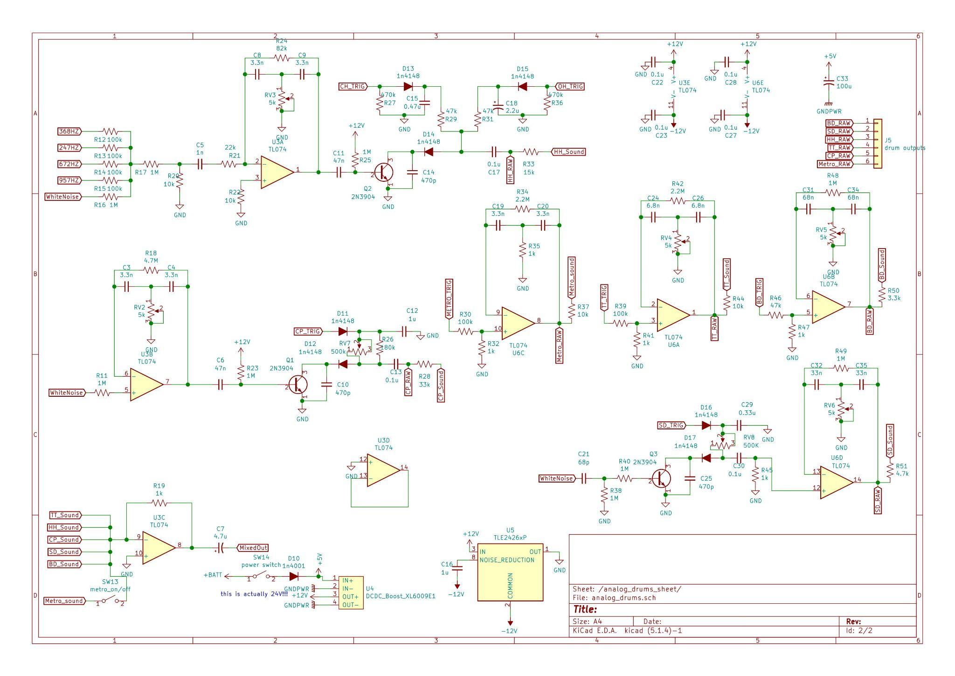
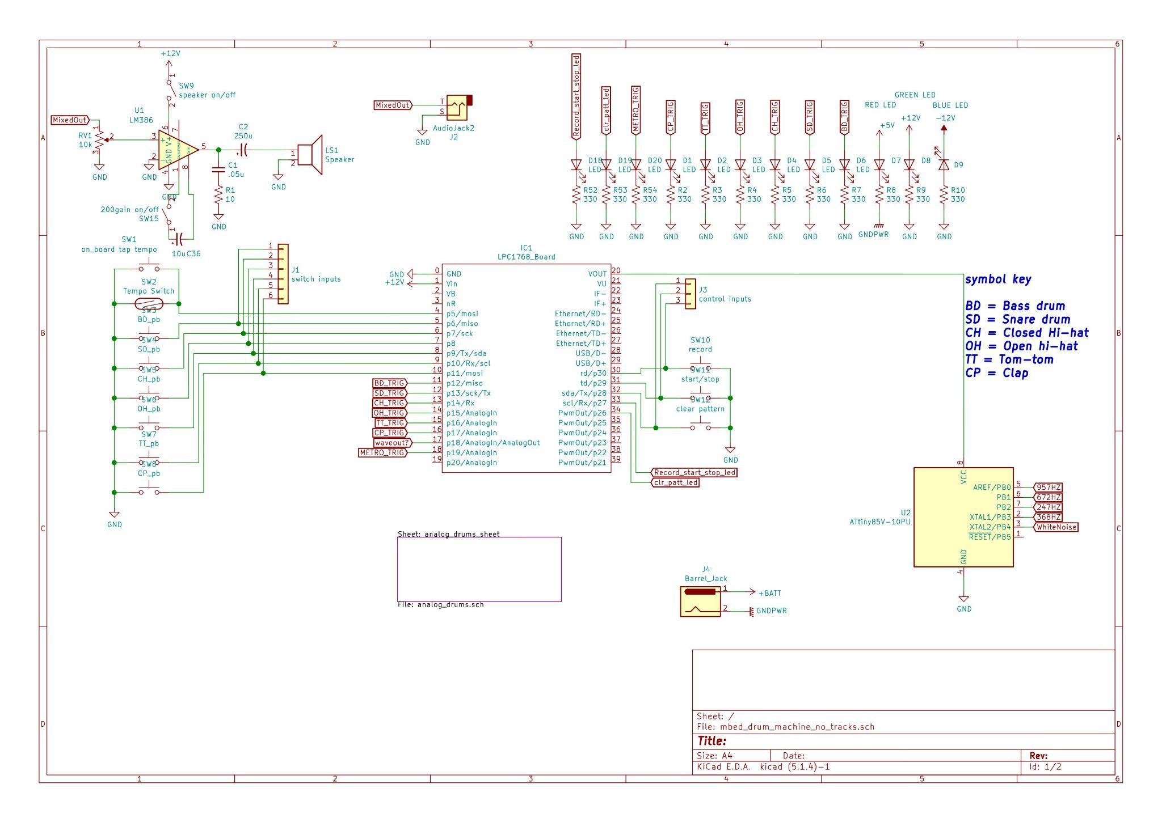
Project Idea
Create a drum machine that uses analog circuits to produce common drum sounds
Use an mbed microcontroller to play those sounds and add functionality like record and playback to allow the user to create music in real time

Slide 3
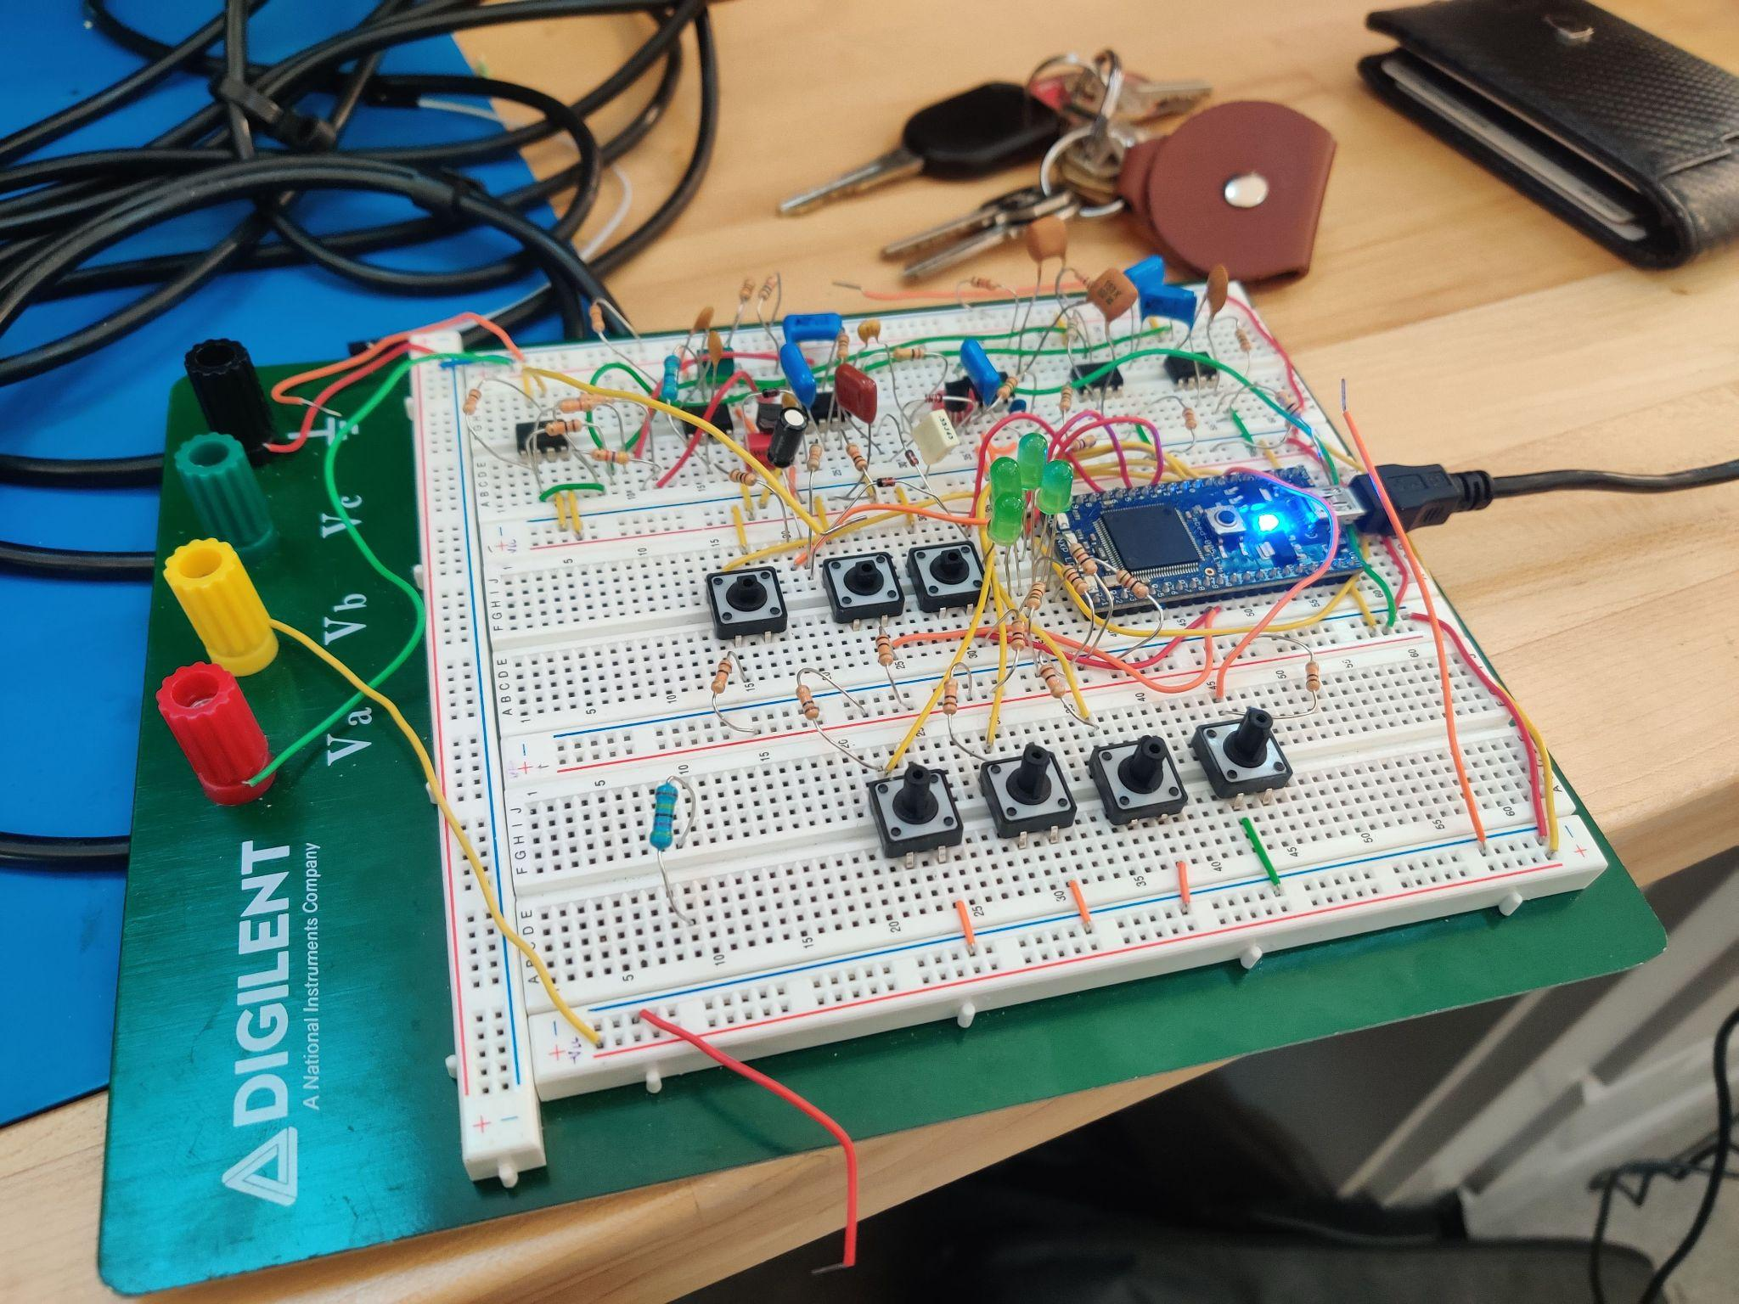
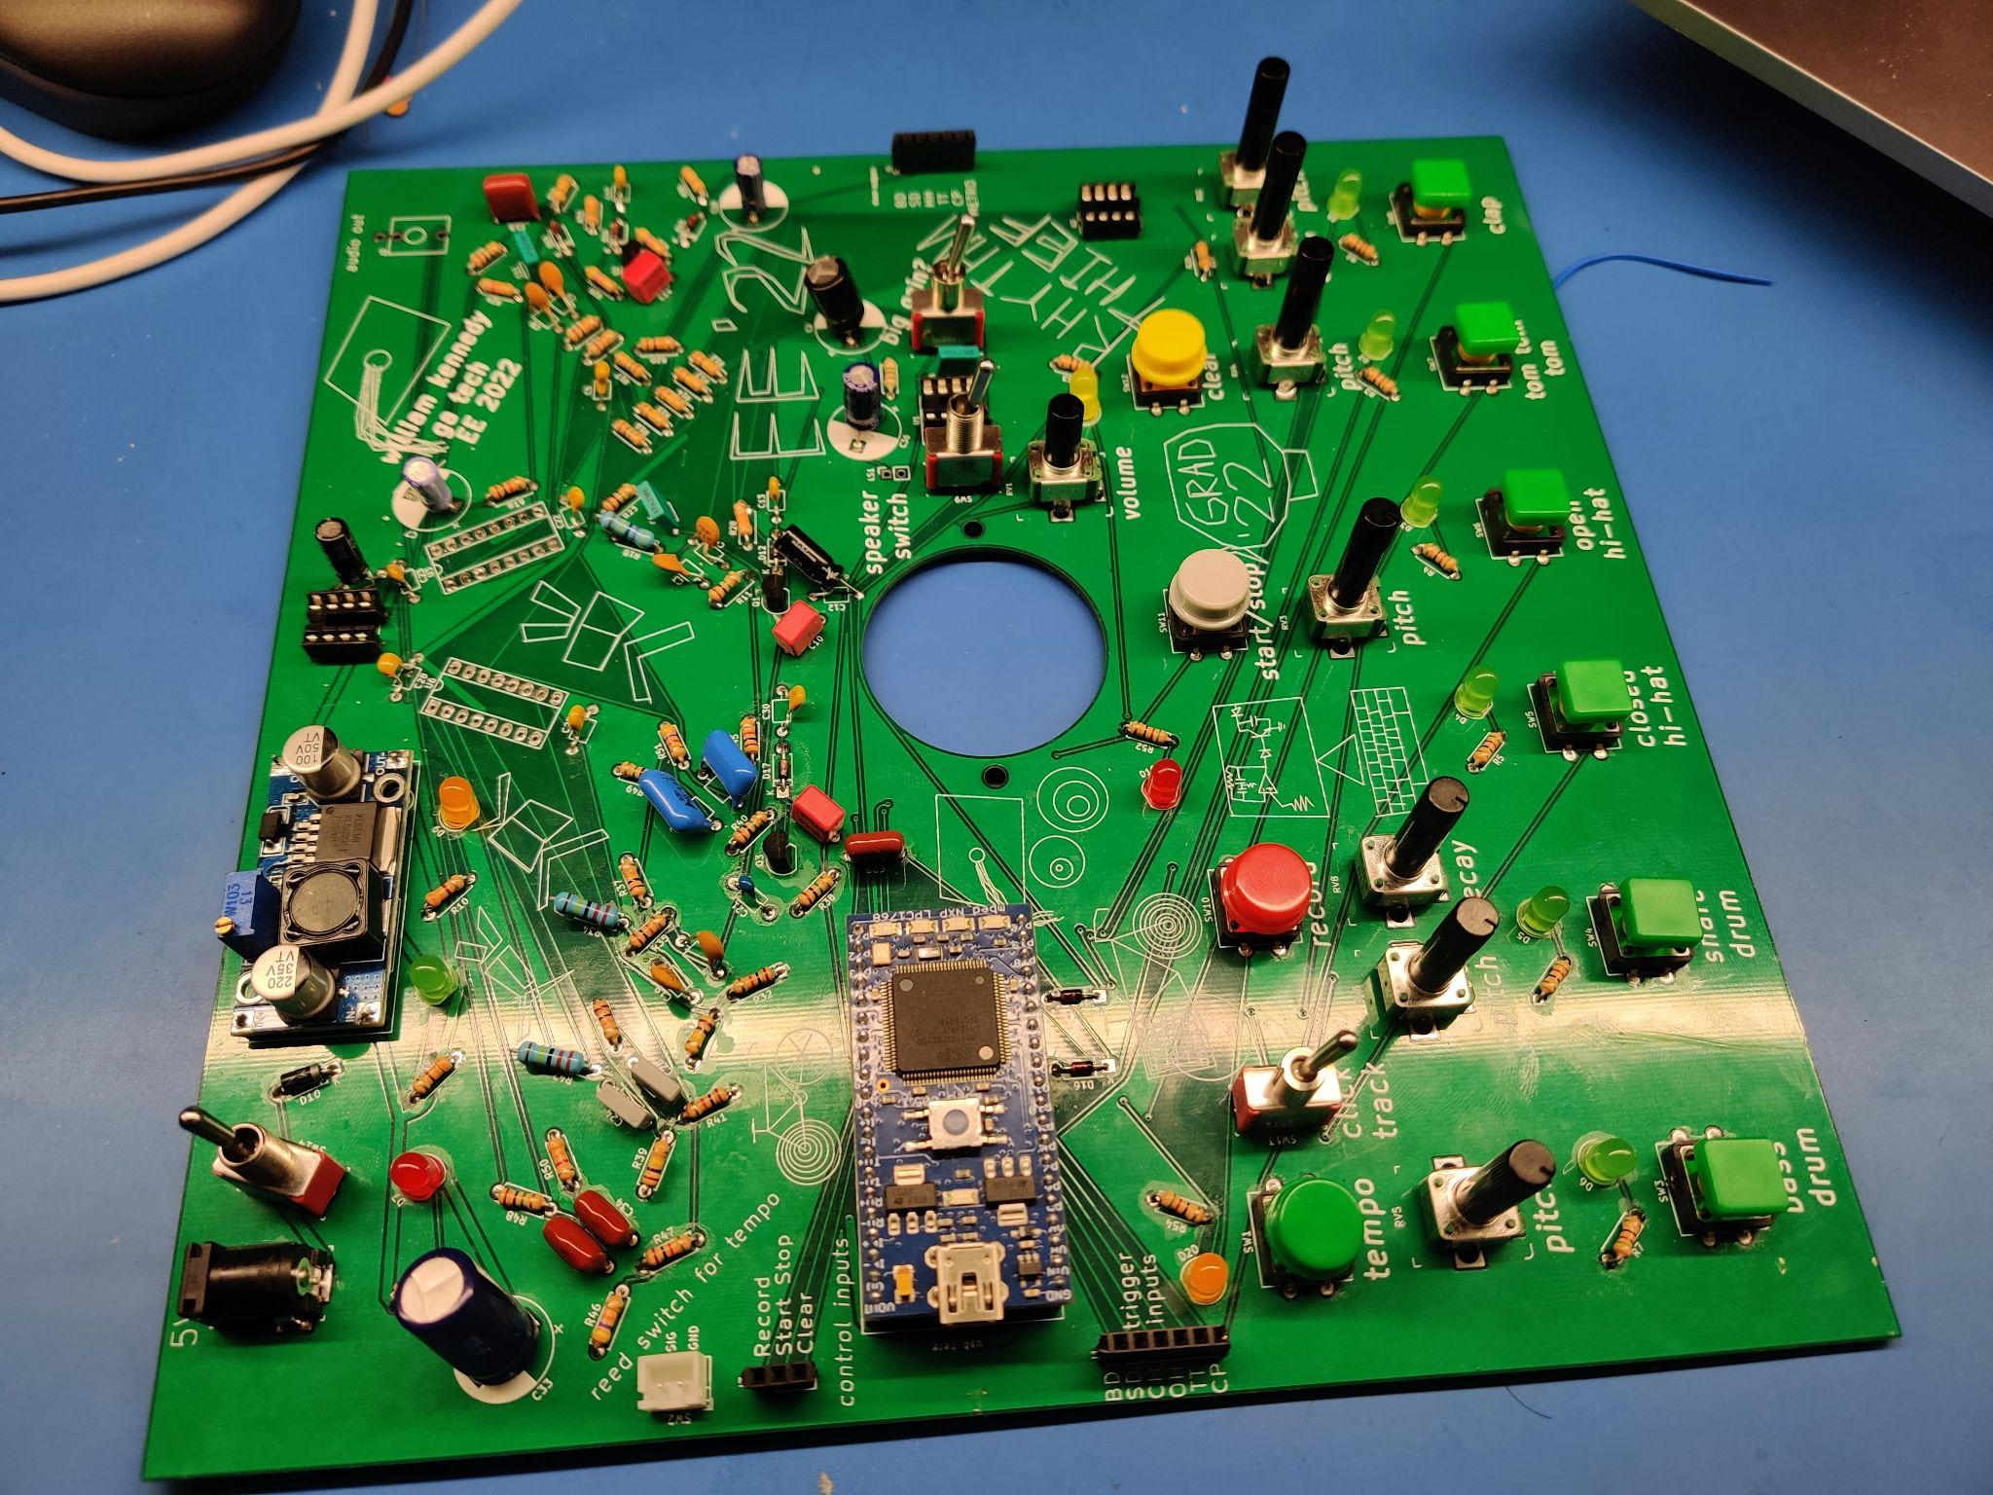
Hardware

Slide 4
Software
Main loop check for if buttons are being pressed and runs code for entering different modes
Record Mode: After the record button is pressed, the mbed records the drums being hit by the user and begins overdubbing (playing them back while recording). It is able to record up to one hit per drum during each set time period called a step(set by the tempo, 0.5 seconds by default). And it records a number of steps equal to the sequence length(currently 8) before it resets to the beginning of the sequence and overdubbs the sequence recorded while recording any beats to add to the sequence. Hitting the record button again leaves the RecordMode
Playback Mode: After the playback button is pressed, the mbed continiously loops through the last sequence recorded. Normal drum functionality is preserved so the user can still make new drum sounds to produce music while the sequence is being played back
TapTempo Mode- changes the time increment of each step based on how fast the tempo button is pressed

Slide 5

Demo

Slide 6
Conclusion
It is fairly straightforward to create an instrument with microcontroller
Making the software was most time consuming
Creating analog circuit was simpler than we thought
Power system was challenging (split rail for op amps)
Looking back, we would begin on the software earlier
Future work: power the PCB with batteries, make the bike tap tempo more responsive.

